Slide 1
HARM REDUCTION
Reid Getty, Outreach Worker for NCHRC

Slide 2

NCHRC
North Carolina Harm Reduction Coalition (NCHRC) is one of North Carolina’s comprehensive harm reduction programs. NCHRC engages in grassroots advocacy, resource development, coalition building and direct services for and those made vulnerable by drug use, sex work, overdose, immigration status, gender, STIs, HIV and hepatitis.

Slide 3
EVERYDAY HR
Sun Screen
Condoms
Seat belts
Bicycle Helmets
Designated driver
Blood alcohol levels
Nicotine patches/gum
Needle Exchange

Slide 4
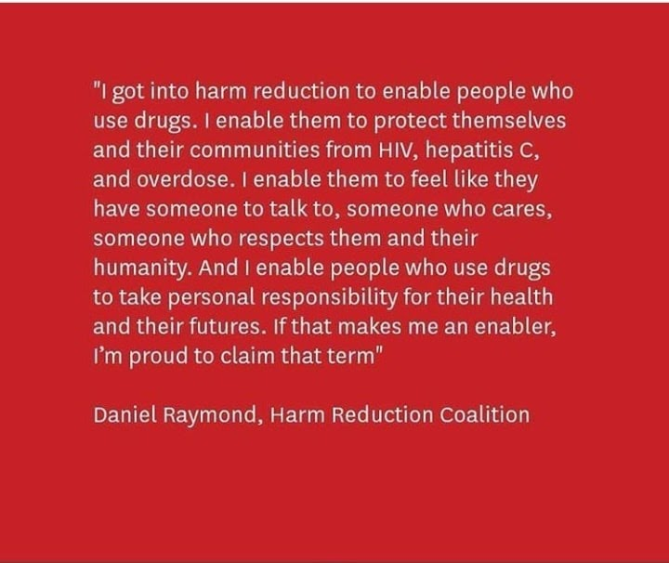
HARM REDUCTION
Harm reduction movements began in the United States during the 1980s in response to the devastation of the draconian policies on people who use drugs and the high incidences of HIV infection among people who inject drugs

Slide 5
WHAT IS HARM REDUCTION
Framework for working with people who use drugs
Strives to reduce consequences of risky behavior
Includes strategies, philosophies, and social change agendas
Seeks to maximize social & health assistance, disease prevention & education, while minimizing repressive & punitive measures
HR does not approach drug use as a criminal or medical issue
Discussing and problem-solving risk factors
Recognizes the right for comprehensive, non-judgmental medical and social service and the fulfillment of basic needs of all individuals and communities, including users, their loved ones, and the communities affected by drug use
HR has a ripple effect within communities

Slide 6
SSP Basics
SSPs offer a range of services to people impacted by injection drug use, including sterile injection supplies, HIV/HCV testing, access to drug treatment, naloxone, housing, and employment opportunities. SSPs also collect and dispose of used syringes.
Recognizes that the realities of poverty, class, racism, social isolation, past trauma, sex-based discrimination and other social inequalities affect both people’s vulnerability to and capacity for effectively dealing with drug-related harm.
Does not attempt to minimize or ignore the real and tragic harm and danger associated with licit and illicit drug use.

Slide 7
SYRINGE EXCHANGE STARTS A CONVERSATION
Syringe Exchange Services
Educational Materials
Syringe & Supply Access
Secure Disposal
Naloxone Kits and Referrals
Consultations and Referrals
Safer Use Education
Support Groups and Advocacy
Medical and Social Services, Referrals
Overdose Prevention
HCV, HIV Testing and Care
Post-Overdose Response
ED Care Linkages
Endocarditis, Sepsis Education, Counseling
MAT Access
Expanded Sexual Health
People who use exchanges care about their health

Slide 8
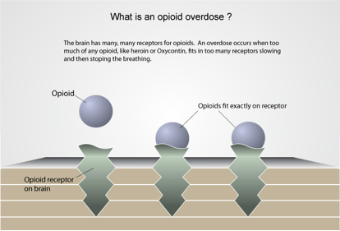
Opiate Overdose
When opioids latch onto brain receptors, they tell respiratory system to slow.
Too much of opioids hitting receptors caused by a high influx of opioids means respiratory system slows.

Slide 9
Overdose Symptoms
Loss of consciousness
Unresponsive to outside stimulus
Awake, but unable to talk
Breathing is very slow and shallow, erratic, or has stopped
For lighter skinned people, the skin tone turns bluish purple, for darker skinned people, it turns grayish or ashen.
Choking sounds, or a snore-like gurgling noise (sometimes called the “death rattle”)
Vomiting
Body is very limp
Face is very pale or clammy
Fingertips and lips turn blue or purplish black
Pulse (heartbeat) is slow, erratic, or not there at all

Slide 10
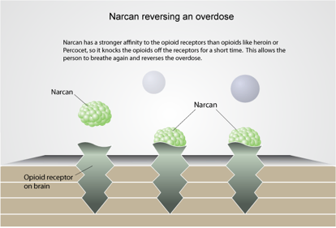
Naloxone
Sternum Rub
Administer Naloxone
Call 911
Rescue Breathing
Next Dose
Stay for Hours if no ER

Slide 11
Calling 911
Call 911
Clearly state address
Tell the operator that the person is not breathing
North Carolina’s 911 Good Samaritan Law will protect you from prosecution for some drug offenses if you call 911 to report an overdose

Slide 12
Current Good Sam

Slide 13
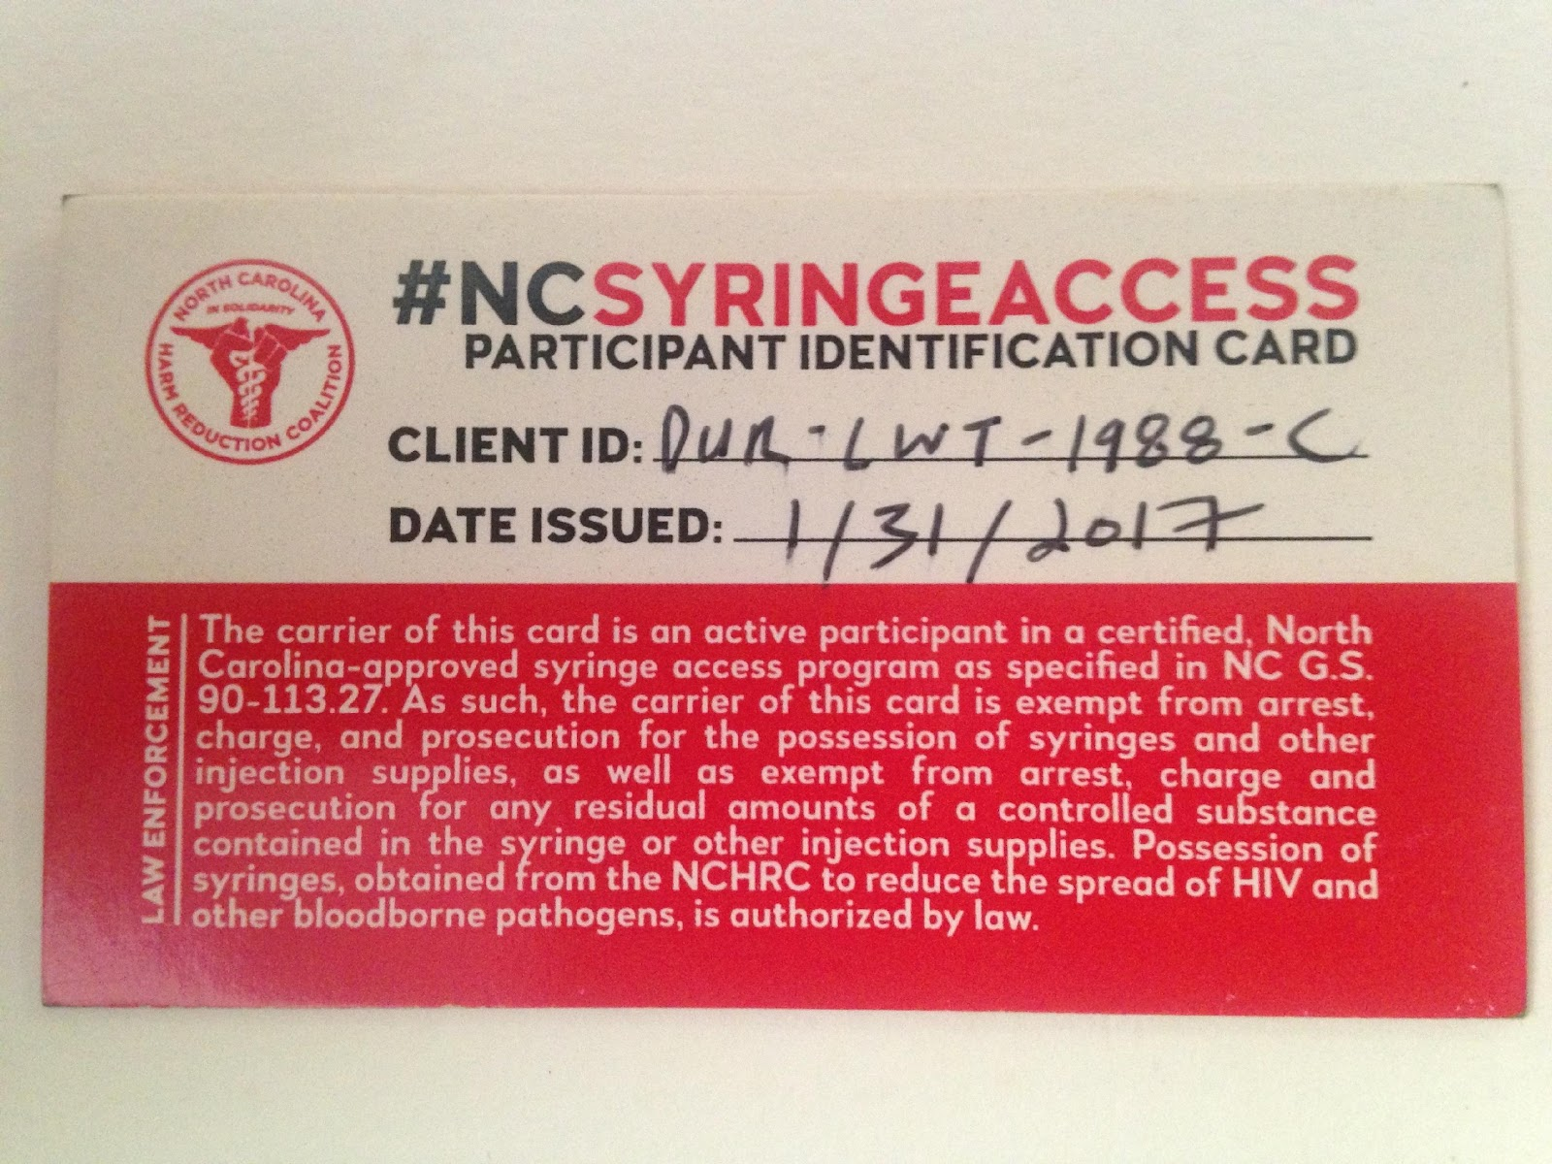
Protections
Under G.S. 90-113.27, which legalized syringe service programs in July 2016, participants cannot be charged or prosecuted for items obtained from or returned to an exchange or for drug residue in those items provided they present written verification to an officer that the items were obtained from an exchange

Slide 14
Overamping
Psychological
Physical
Extreme anxiety
Panic
Extreme paranoia
Hallucinations
Extreme agitation
Increased aggressiveness
Agitation, restlessness,
Irritability
Hypervigilance (being super
aware of your environment,
sounds, people, etc.)
Enhanced sensory awareness
Suspiciousness
Nausea and/or vomiting
Falling asleep/passing out
(but still breathing)
Chest pain or a tightening in
the chest
High temperature/sweating
profusely, often with chills
Fast heart rate, racing pulse
Irregular breathing or
shortness of breath
Seizure/convulsions
Stroke
Limb jerking or rigidity
Feeling paralyzed but you are
awake
Severe headache
Hypertension (elevated blood
pressure)
Teeth grinding
Insomnia or decreased need
or sleep
Tremors

Slide 15
Preventing Overdose/Amp
Opiates
Stimulants
Testing drugs
Tester shot/etc
Go Slow
Hydrated, fed, safe
Know Tolerance
ROI
Health Risks known
Hydrated
Fed
Sleep
Testing drugs
Safe
Health Risks known
ROI

Slide 16
Other People’s Needles and PPE
Do not let container get too full.
Do not recap the needle.
Do not touch the needle.
Do not bend or break off the needle.
Do not take the needle off of the syringe.
Do not remove needles from sharps container
Do not put your hand in the sharps container EVER.
When disposing of needles found outside, in unsafe places, of unknown origin, or returned for SSP purposes, it is important to handle the containers safely.
Gloves, tongs or grabbers, and safe disposal containers should be always available, as well as bleach disinfectant for cleaning.

Slide 17
Why Sharps safety matters
Hep c
hiv
Can live outside the body on surfaces for up to 6 weeks at room temp
Risk of transmission from needlestick from hep positive source is between 2-10%
Treatment for Hep-C is between 8-12 weeks
Can take between 8-11 weeks for bloodwork to test positive on antibody test
Can live outside body for up to 6 days, but virus deteriorates rapidly
Dies within seconds when exposed to light and air
PEP (post-exposure prophylaxis) is started withing 72 hours and continues for 28 days after exposure

Slide 18
Questions? Comments?
reid@nchrc.org
Volunteer at NCHRC volunteer@nchrc.org

